Slide 1


Phd thesis
Particle Based Modelling of Scrap Handling for Green Steel Production
Notes:
Companion deck to the main 15-minute presentation. Every claim in the main deck is supported here by a figure taken directly from the papers in the repository ('papers/particles-based models'). Use as backup / evidence slides, or walk through the ~6 strongest (S3, S7, S8, S10, S11, S12) if time allows.

Slide 2
HOW TO READ THIS DECK
Evidence Map: From Particle Physics to the Furnace
1
Shape & contact
2
Shape → flow
3
Belt & chevron
how non-spherical scrap is represented
packing, angle of repose, discharge
DEM at the moving boundary
4
Chute & upscaling
5
Vibratory feeding
6
Into the furnace
flow, build-up, scaling limits
sorting, segregation, design rules
late melting — and the infeed gap
Each of the 6 blocks = one slide below with figures from the papers + the statements they support.
Particle-Based Modelling of Scrap Handling • evidence from the literature • TU Delft × Tata Steel
2
Notes:
One minute: show the committee the evidence chain. 35 figures from 10 papers in the repository, each supporting a specific statement from the main deck.

Slide 3
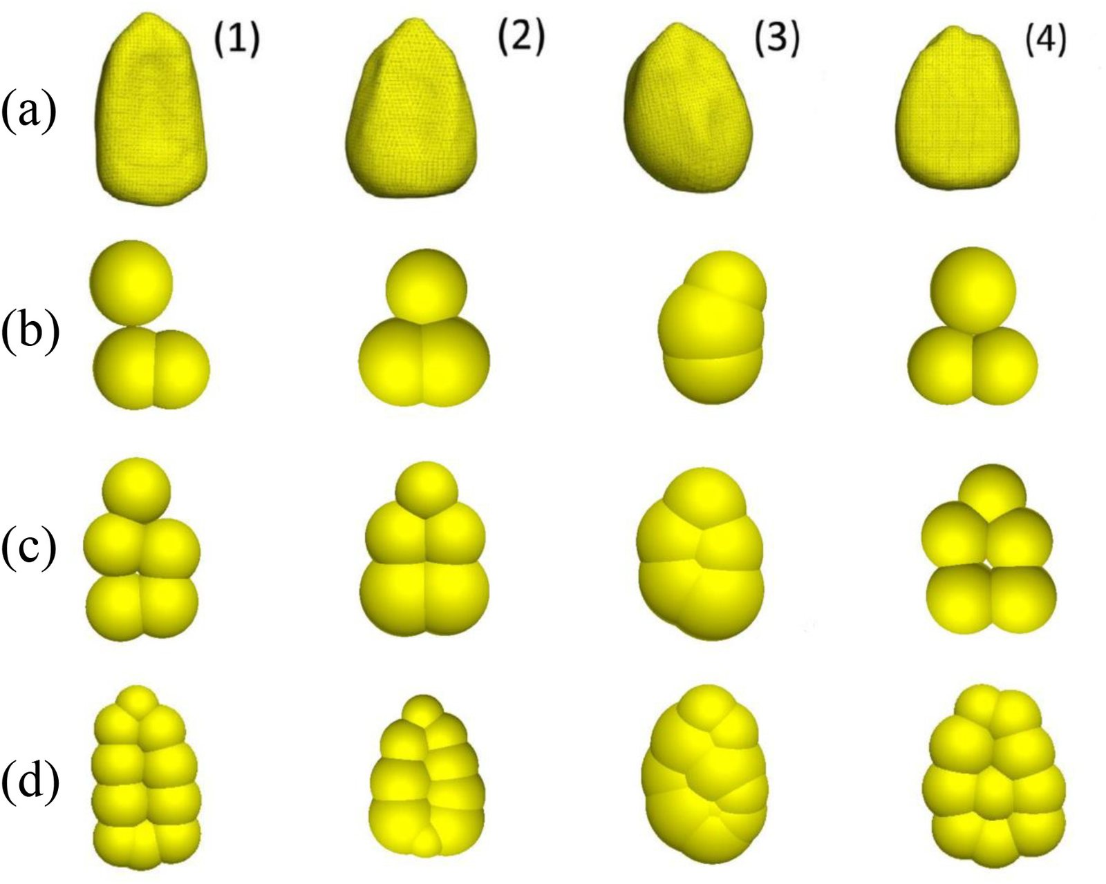
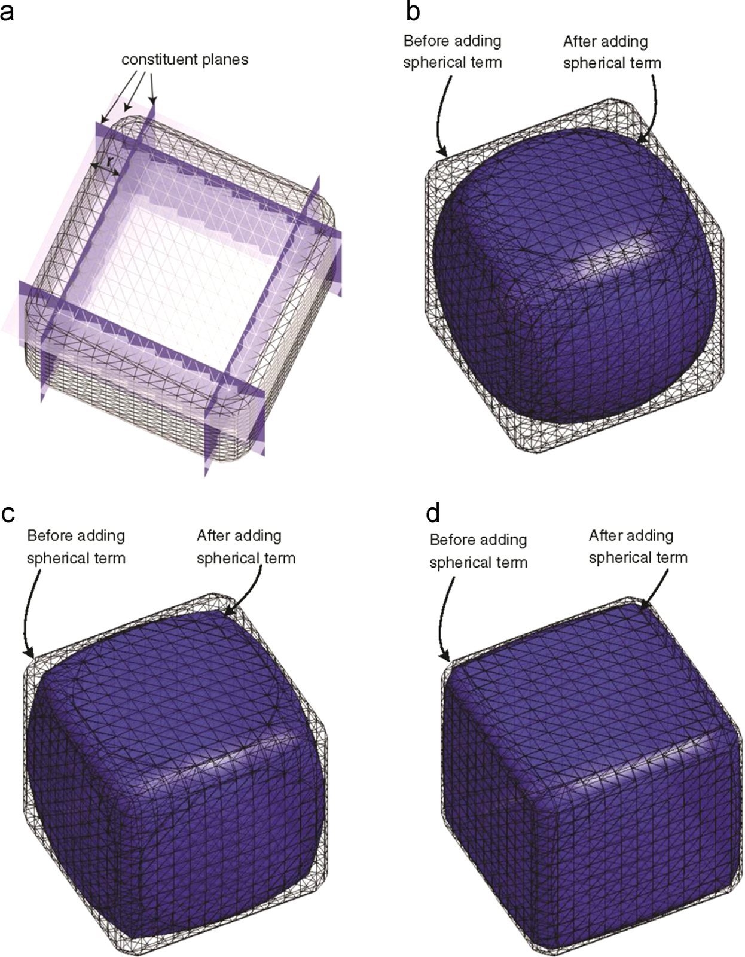
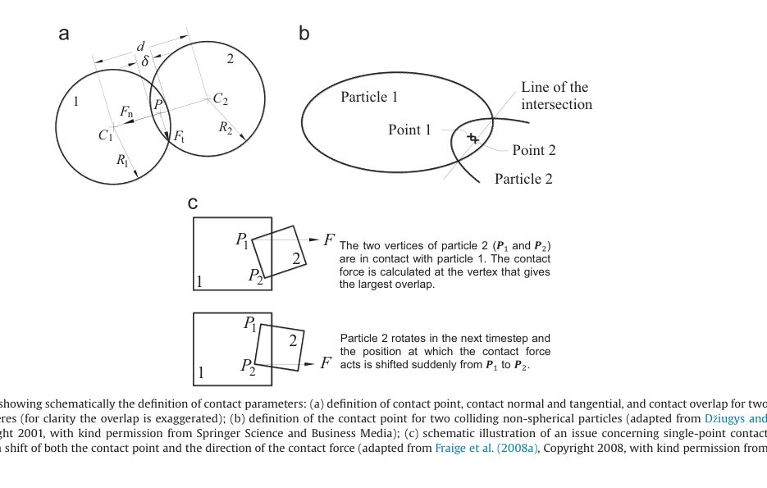
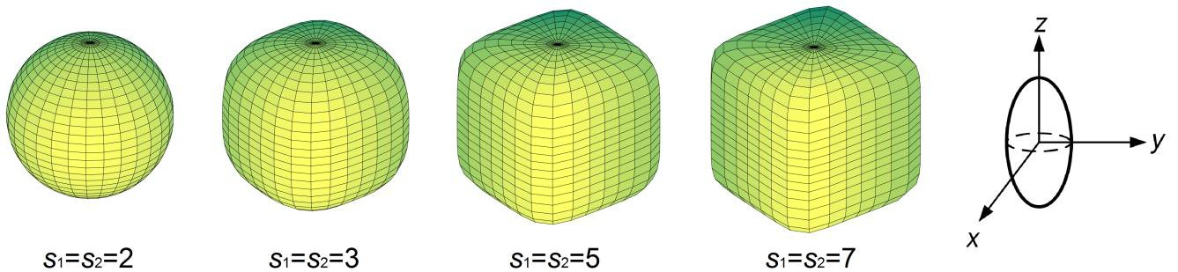
EVIDENCE 1 — SHAPE & CONTACT
Scrap Is Not Spherical: Representation & Contact Mechanics
What the figures show
• Multi-sphere clusters are the workhorse: 3D-scanned grains → STL → 3/5/10-sphere “clumps” (Rossow & Coetzee 2021, Fig. 1)
• Polyhedra / voxelised meshes capture angular, non-convex geometry directly (Lu et al. 2015, Fig. 14)
• Super-ellipsoids vary blockiness continuously via the shape index s (You et al. 2018)
• Every contact carries Fn + Ft; defining the contact point is where non-sphericals get hard (Lu et al. 2015, Fig. 3)
Scanned grains → 3 / 5 / 10-sphere multi-sphere clumps (Rossow & Coetzee, 2021, Fig. 1)
Voxelised non-convex polyhedron: vertex/edge/face offsets (Lu et al., 2015, Fig. 14)
Contact point, normal, overlap — spheres (a) vs non-sphericals (b, c) (Lu et al., 2015, Fig. 3)
Super-ellipsoid family, s = 2…7 (You et al., 2018)
Particle-Based Modelling of Scrap Handling • evidence from the literature • TU Delft × Tata Steel
3
Notes:
Walk the four quadrants: (top-left) the clump workflow used for irregular particles — the same workflow applies to 3D-scanned scrap; (top-right) angular geometry via voxels; (bottom-left) why contact mechanics is harder for non-sphericals (Fig. 3c: sudden contact-point jumps → multi-point contact needed); (bottom-right) smooth shapes via super-ellipsoids. Message: representation choice = physics choice, and it drives contact-detection cost (>80% of CPU, Lu 2015).

Slide 4
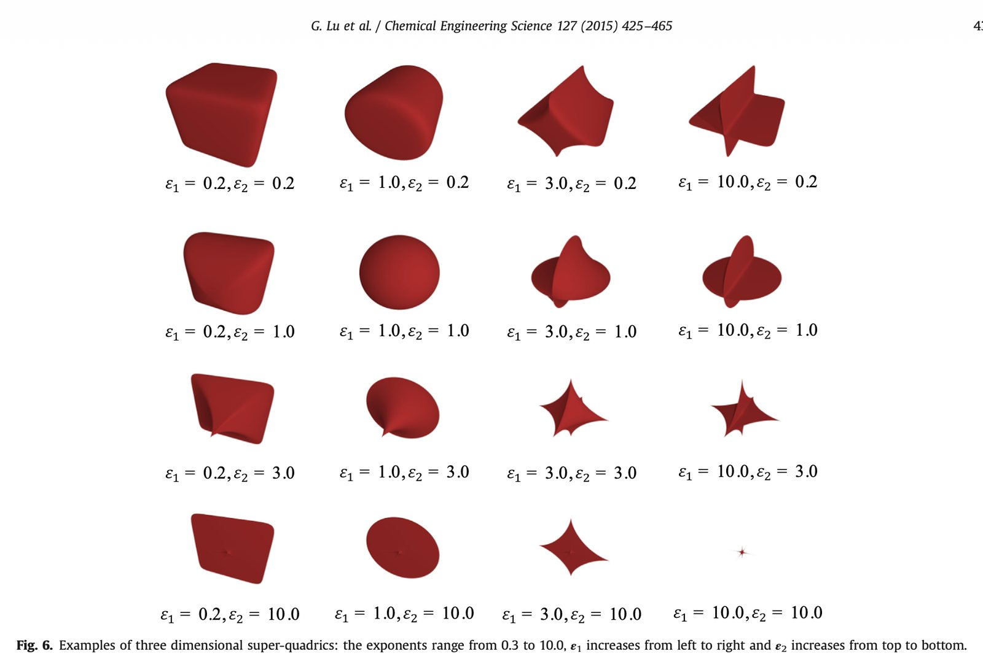

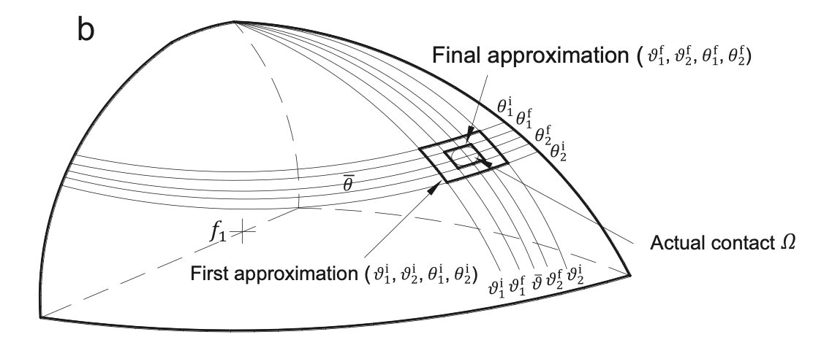
EVIDENCE 1 — SHAPE & CONTACT
Super-Quadrics: One Equation, a Whole Shape Family
What the figures show
• The super-quadric equation sweeps ellipsoid → blocky → star-like shapes by the exponents ε₁, ε₂ (Lu et al. 2015, Fig. 6)
• The surface normal is available analytically — a compact, parameterisable description (Lu et al. 2015, Eq. 16)
• Contact between two super-quadrics is found iteratively inside a curvilinear region Ω (Lu et al. 2015, Fig. 4b)
• Best for smooth, regular, systematically varied shapes; weak for sharp edges & flat faces
Fig. 6 — 3D super-quadric family: ε₁ (left→right), ε₂ (top→bottom), exponents 0.3–10 (Lu et al., 2015)
Eq. (16) — implicit 3D super-quadric function (Lu et al., 2015)
Fig. 4b — contact region Ω approximation (Lu et al., 2015)
Particle-Based Modelling of Scrap Handling • evidence from the literature • TU Delft × Tata Steel
4
Notes:
For shredded/baled scrap, super-quadrics model the rounded bales; for HMS bundles, polyhedra; for general fragments, multi-sphere clusters from scans. The figure also shows why we don't rely on one representation: every method has a preferred application range (Lu 2015 §7; Zhong 2016).

Slide 5
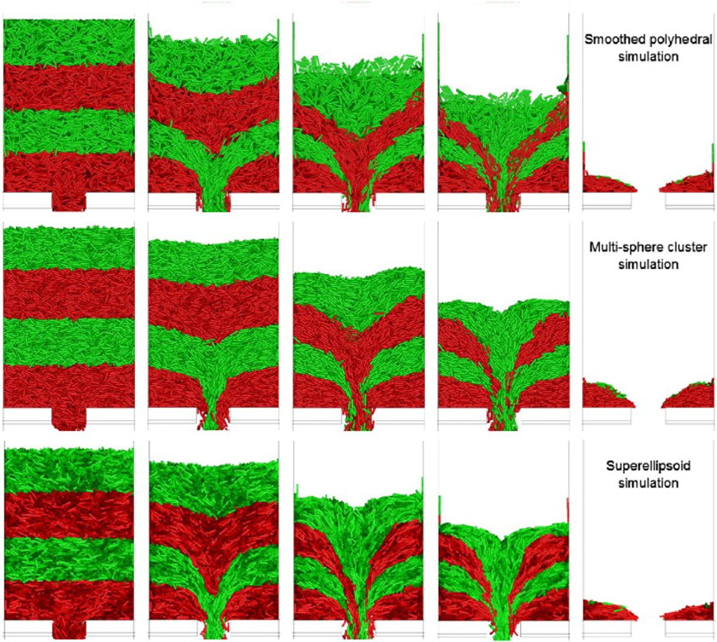
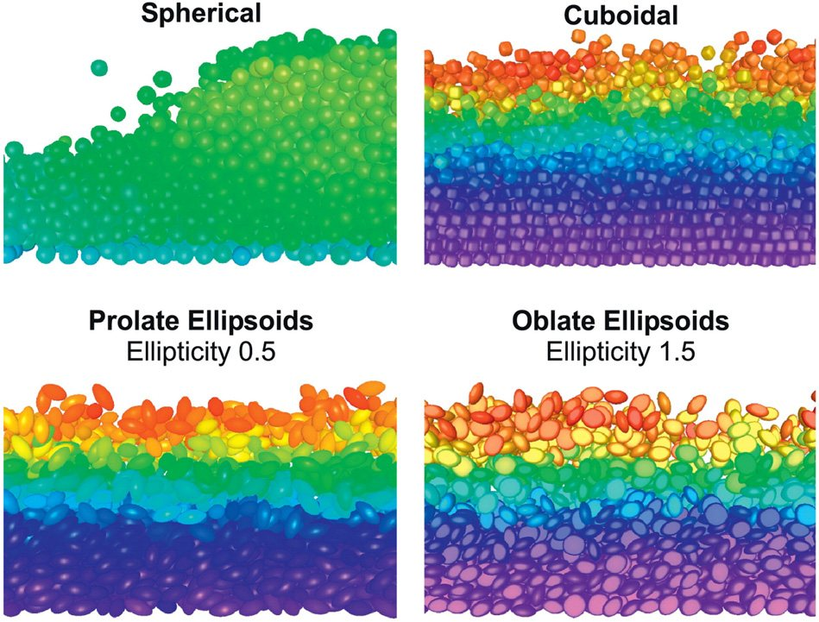
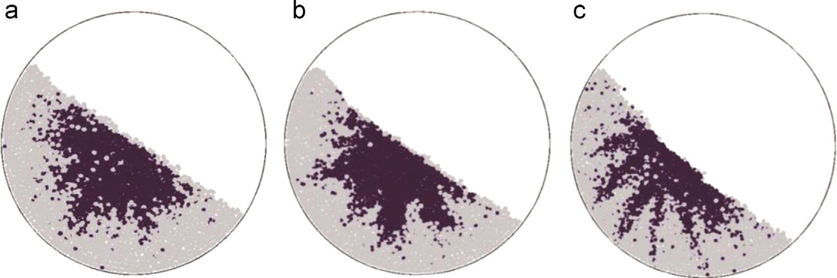
EVIDENCE 2 — SHAPE → FLOW
Shape Decides Packing, Piling and Discharge
• Same material, different shape representation → different hopper discharge (Zhong et al. 2016, Fig. 20)
• Bed structure & layering differ between spherical, cuboidal, prolate and oblate particles (Zhong et al. 2016, Fig. 45)
• Angle of repose grows as particles become less spherical (Lu et al. 2015, Fig. 32) — the classic calibration experiment
Hopper discharge: smoothed polyhedra / multi-sphere / super-ellipsoid (Zhong et al., 2016, Fig. 20)
Bed structure by shape (Zhong et al., 2016, Fig. 45)
Angle-of-repose piles — shape effect (Lu et al., 2015, Fig. 32)
Particle-Based Modelling of Scrap Handling • evidence from the literature • TU Delft × Tata Steel
5
Notes:
These three figures justify the whole non-spherical effort: shape changes discharge, layering and pile angle — exactly the phenomena behind chute blockage, bridging and segregation of scrap. Note AOR (angle of repose) as the cheapest lab calibration for our virtual scrap.

Slide 6
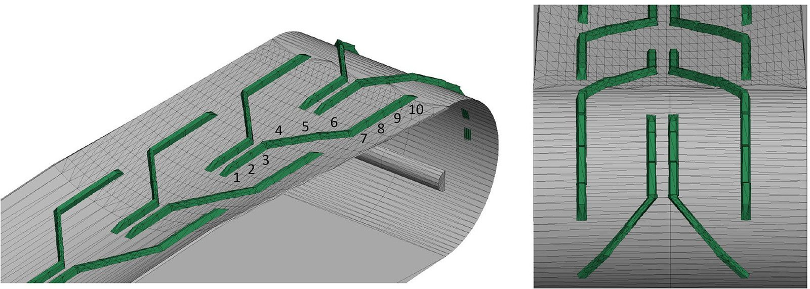
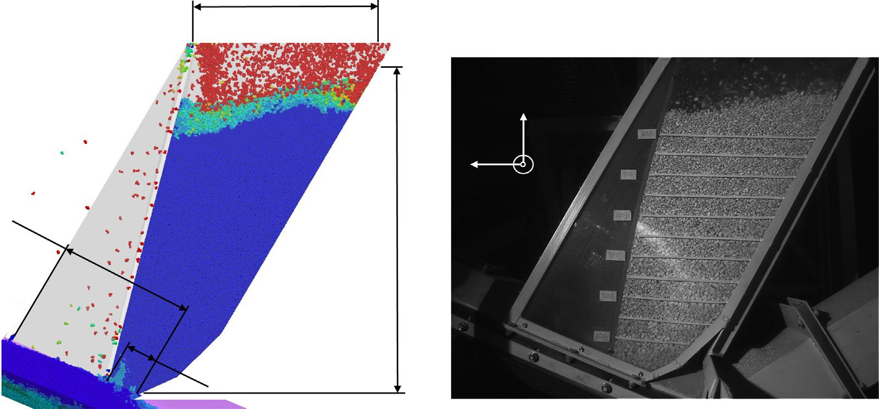
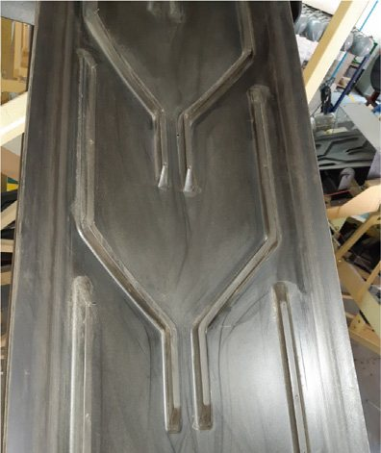
EVIDENCE 3 — BELT & CHEVRON
The Chevron Belt: DEM at the Moving Boundary
What the figures show
• First DEM study of a chevron-patterned belt: CAD model and the physical test belt (Rossow & Coetzee 2021, Fig. 3)
• Wall friction + belt-velocity boundary conditions carry the material — the same physics as a scrap conveyor
• Particle-by-particle comparison with high-speed footage (Rossow & Coetzee 2021, Fig. 8)
Chevron-patterned belt in the DEM model (Rossow & Coetzee, 2021, Fig. 3a)
The physical chevron belt (Rossow & Coetzee, 2021, Fig. 3)
Material flow on the chevron belt — DEM (left) vs high-speed footage (right) (Rossow & Coetzee, 2021, Fig. 8)
Particle-Based Modelling of Scrap Handling • evidence from the literature • TU Delft × Tata Steel
6
Notes:
Chevron belts grip the material by geometry, not friction alone — crucial for scrap. The side-by-side DEM/footage comparison is the validation standard we will reuse for scrap feeders: high-speed video + PIV at Tata Steel NL.

Slide 7
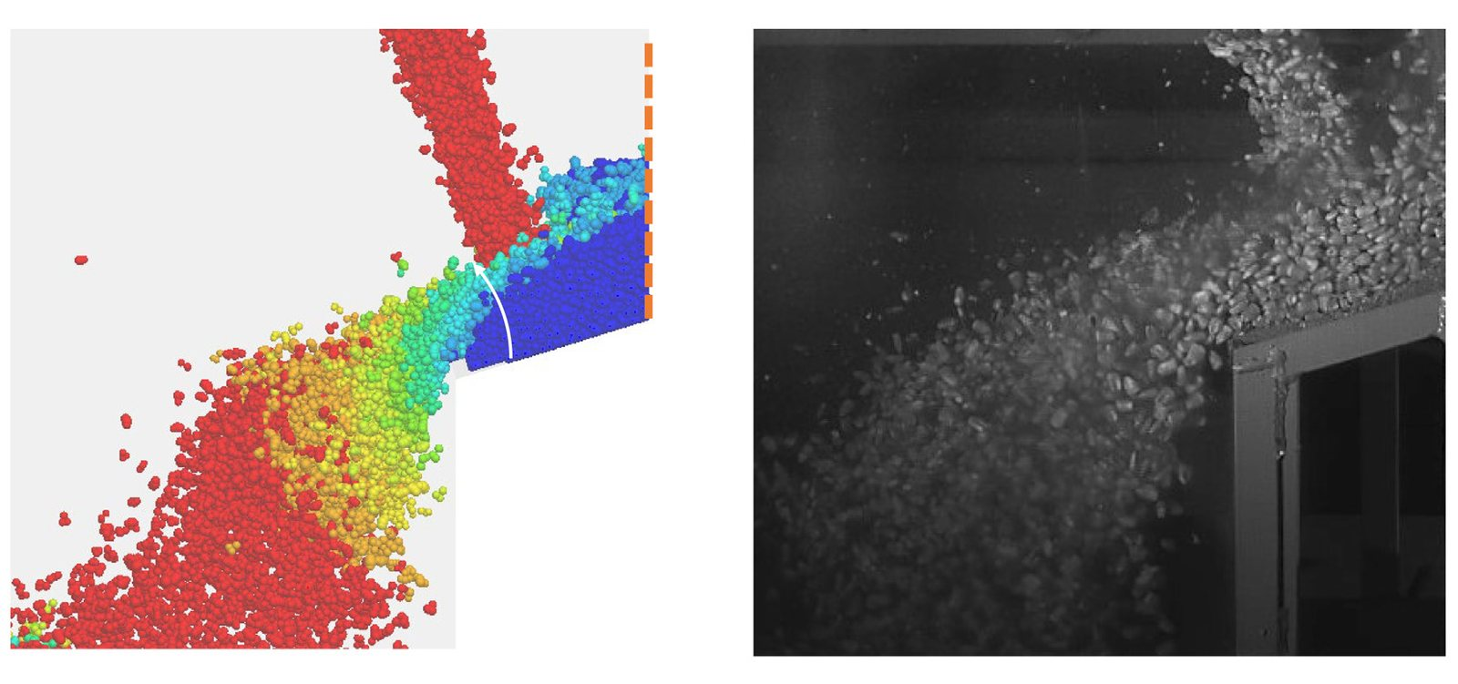
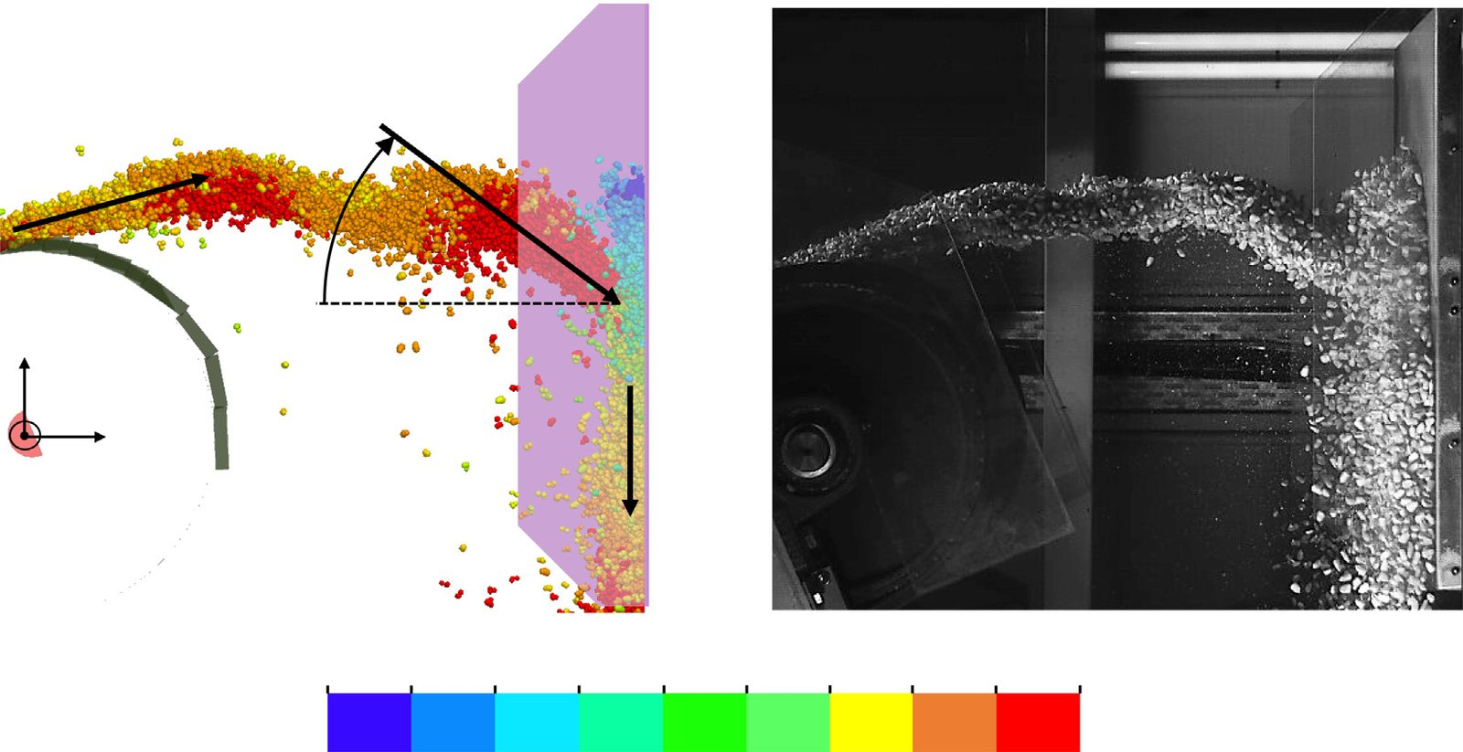
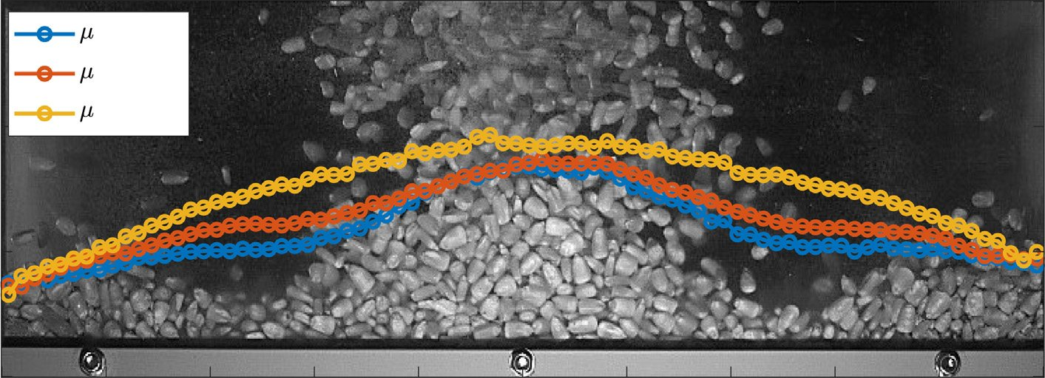
EVIDENCE 4 — CHUTE & TRANSFER
Chute Transfer: DEM Predicts Flow, Build-Up and Blockage
• One calibrated model covers belt → impact plate → hood → rock box → chute (first study to do all of this, Rossow & Coetzee 2021)
• Accuracy vs experiment: mass flow ≤ 5.4%, impact velocity < 6.1%, impact-wall force < 17% — better than analytical models
• Build-up and blockage are predicted, not assumed — the exact failure mode of EAF infeed chutes
Chute transfer flow — DEM (left) vs high-speed footage (right) (Rossow & Coetzee, 2021, Fig. 13)
Rock-box build-up — DEM & experiment (Rossow & Coetzee, 2021, Fig. 21)
Impact-plate outflow velocity field — DEM & footage (Rossow & Coetzee, 2021, Fig. 10)
Particle-Based Modelling of Scrap Handling • evidence from the literature • TU Delft × Tata Steel
7
Notes:
The key quote for the committee: 'DEM can be used with confidence in modelling similar applications if a calibrated parameter set is used, and the guidelines presented here in terms of particle scaling are adhered to' (Rossow & Coetzee, 2021). For EAF scrap: same methodology, more irregular particles.

Slide 8
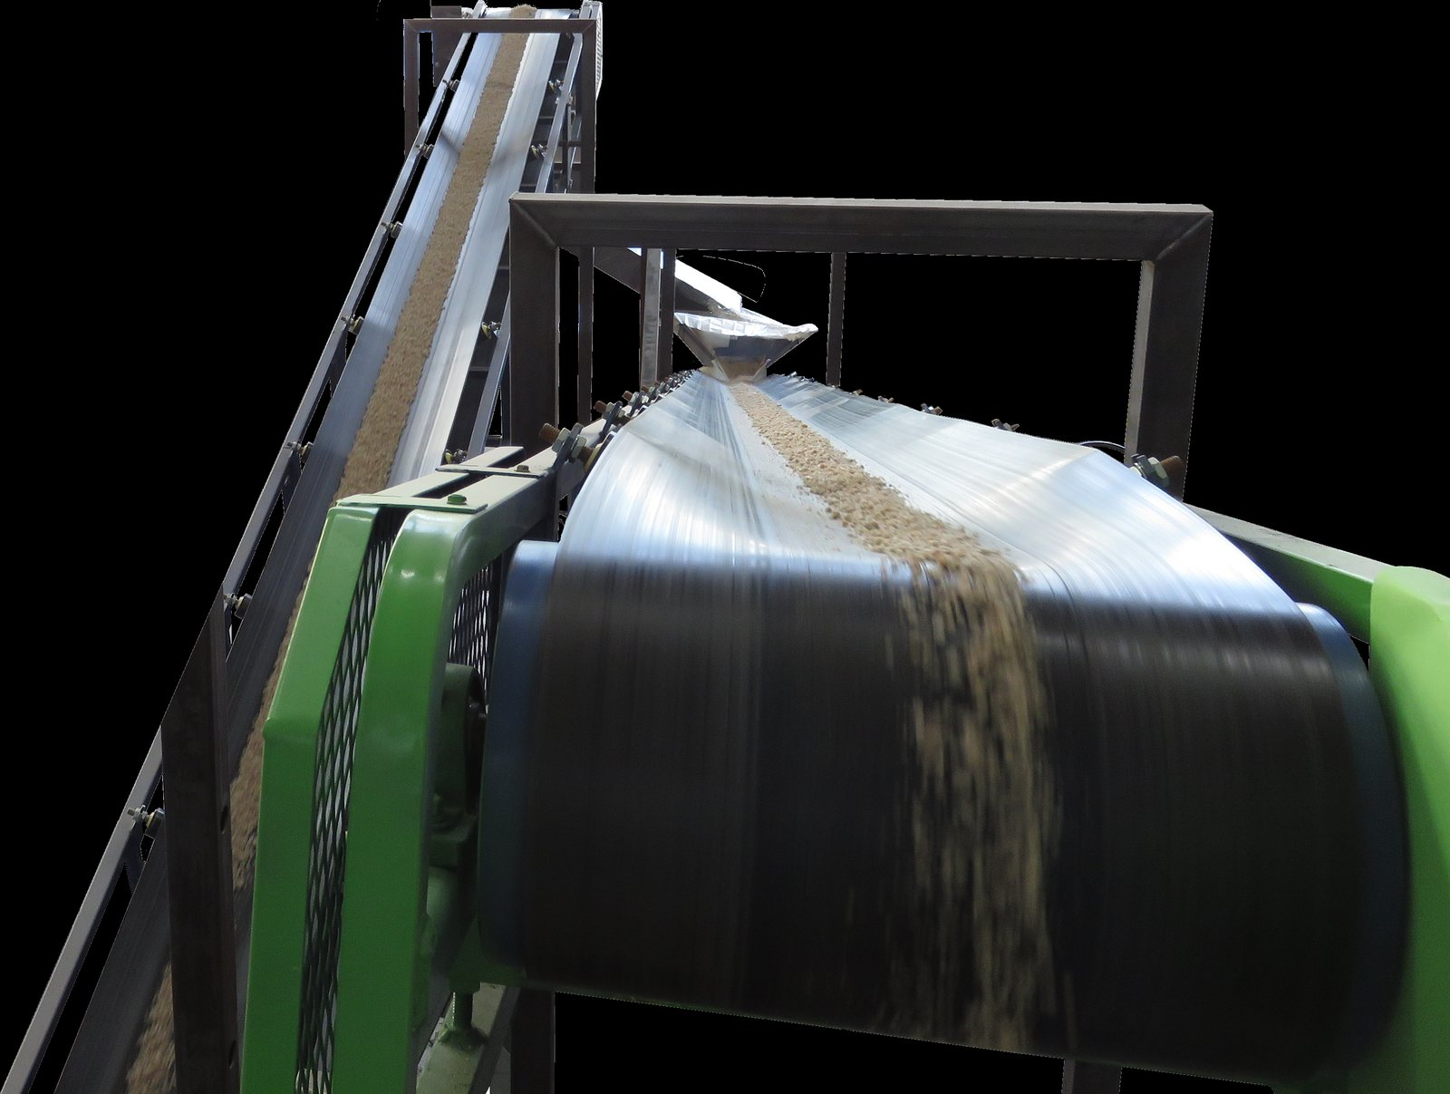
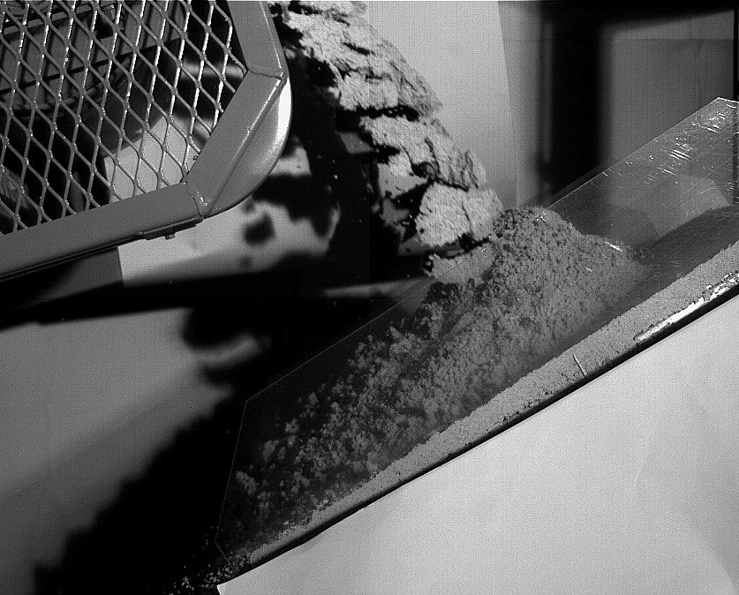
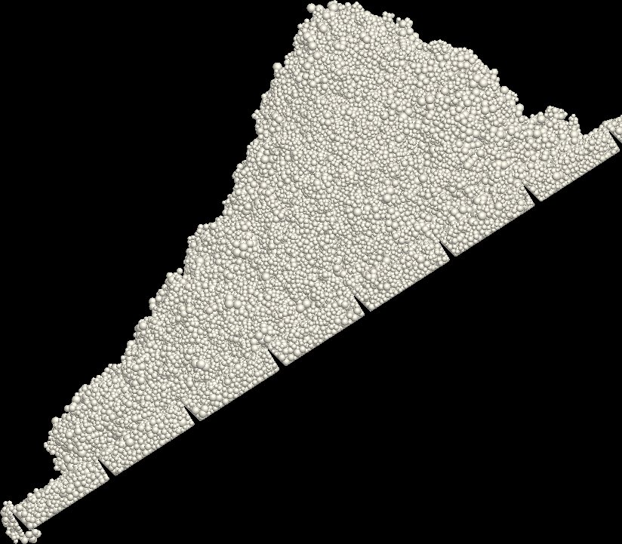
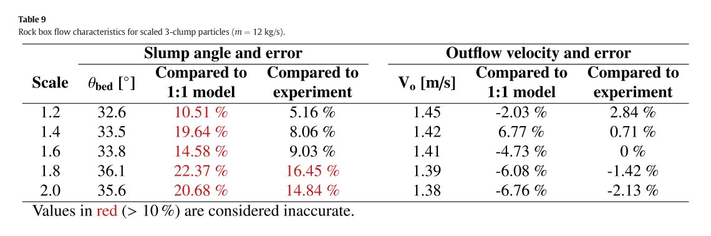
EVIDENCE 4 — CHUTE & TRANSFER
Cohesive Scrap: Build-Up, and the Limits of Upscaling
What the figures show
• Wet-and-sticky material builds up and can block — realistic for dusty/wet scrap (Schefler & Coetzee 2023)
• Upscaled DEM reproduces discharge, build-up, force & residual mass with < 15% error
• But upscaling has hard limits: scale ≤ 1.6 keeps error ≤ 10% (Rossow & Coetzee 2021, Table 9)
• The maximum scale factor is a geometric property of the bulk measure of interest — and grows with cohesion (Schefler & Coetzee 2023)
Discharge from belt to inclined impact plate — experiment (Schefler & Coetzee, 2023)
Adhesion build-up on the plate — experiment (Schefler & Coetzee, 2023)
DEM build-up profile (Schefler & Coetzee, 2023)
Table 9 — scale factor vs error; red = > 10% = inaccurate (Rossow & Coetzee, 2021)
Particle-Based Modelling of Scrap Handling • evidence from the literature • TU Delft × Tata Steel
8
Notes:
This slide answers the inevitable 'how do you simulate metres of scrap?' question with numbers, not promises: 1.6× upscaling is validated (≤10% error), the limit depends on the quantity you care about, and cohesion relaxes the limit. Our coarse-graining strategy inherits exactly these guidelines.

Slide 9
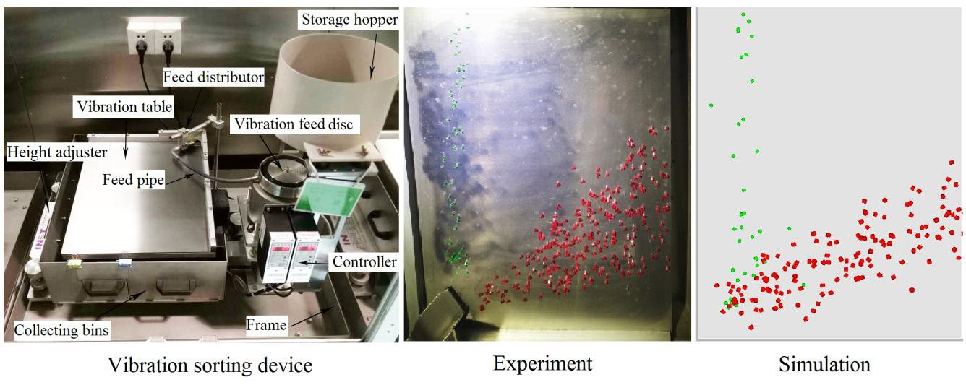
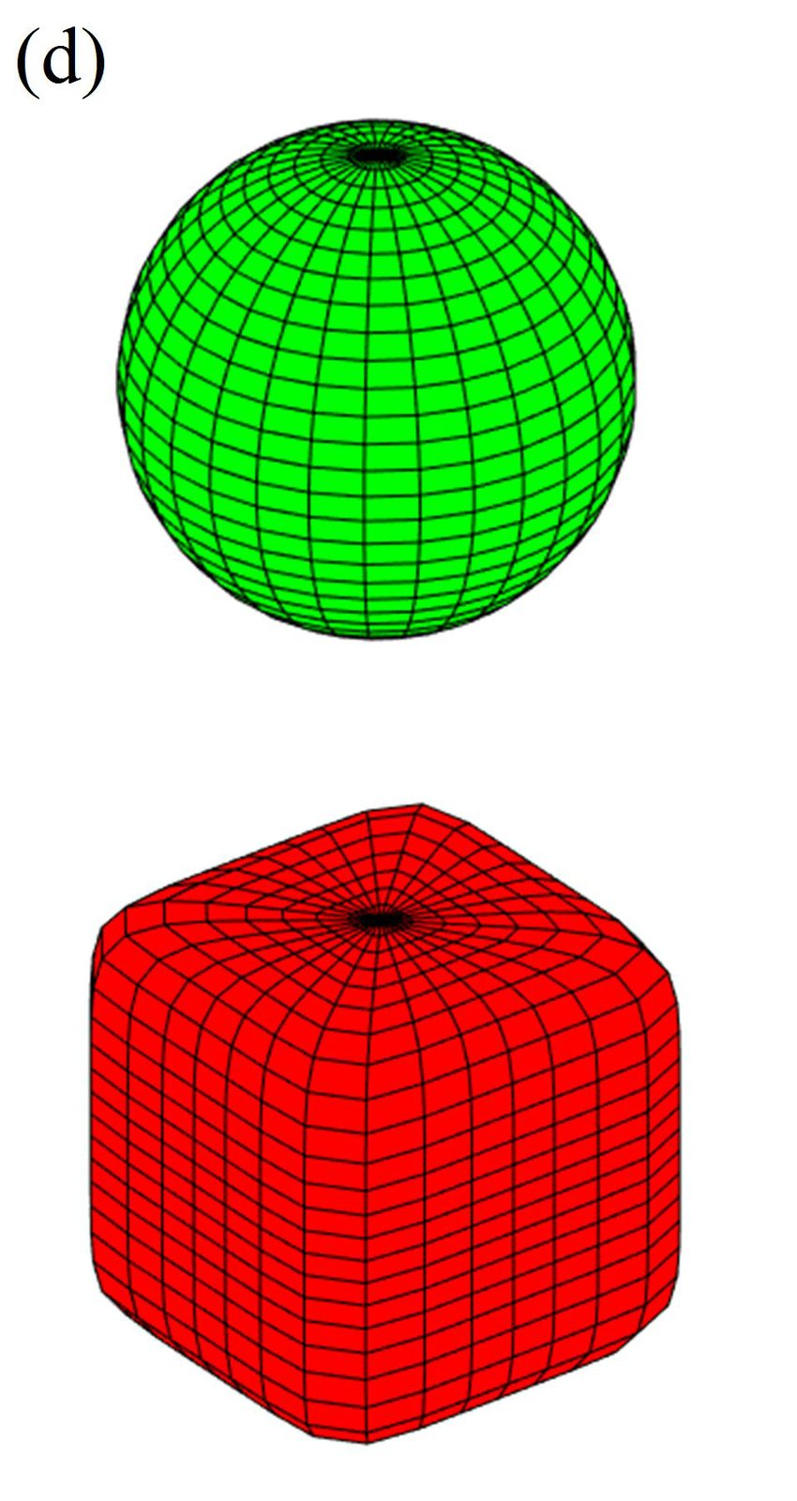
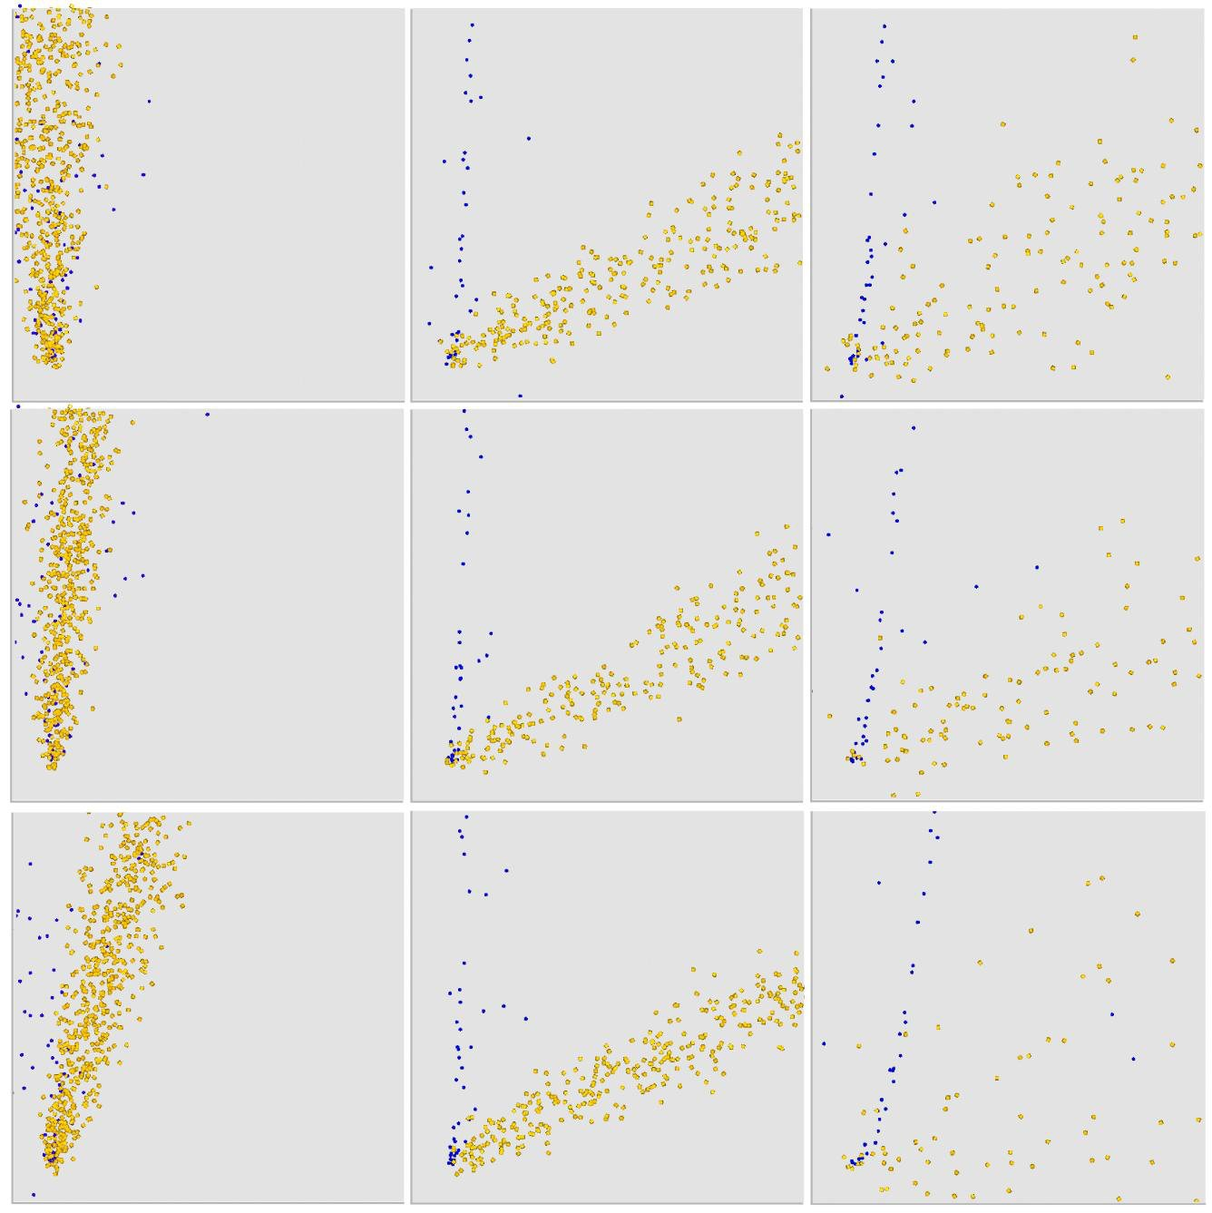
EVIDENCE 5 — VIBRATORY FEEDING
Vibratory Feeders: Sorting, Segregation and a Design Rule
What the figures show
• DEM of an inclined vibrating plate reproduces the sorting experiment (You et al. 2018, Fig. 6)
• Non-spherical test particles modelled as super-ellipsoids (sphere & cube), mixed 1:1
• Vibration frequency & amplitude set the discharge order → structural segregation
• Effective separation when (2πf)²A ≈ 1.5g — a usable design rule for scrap feeders
Vibration sorting device — experiment & DEM side by side (You et al., 2018, Fig. 6)
DEM super-ellipsoid models: sphere & cube (You et al., 2018)
Separation patterns on the plate — DEM (You et al., 2018)
Particle-Based Modelling of Scrap Handling • evidence from the literature • TU Delft × Tata Steel
9
Notes:
Why this matters for scrap: heterogeneous recipes (bales + shreds + HMS) on a vibratory feeder will self-segregate before the chute. The 1.5g rule (You et al. 2018) tells us when sorting happens — we will use it to predict which scrap discharges first and prevent chute blockage.

Slide 10
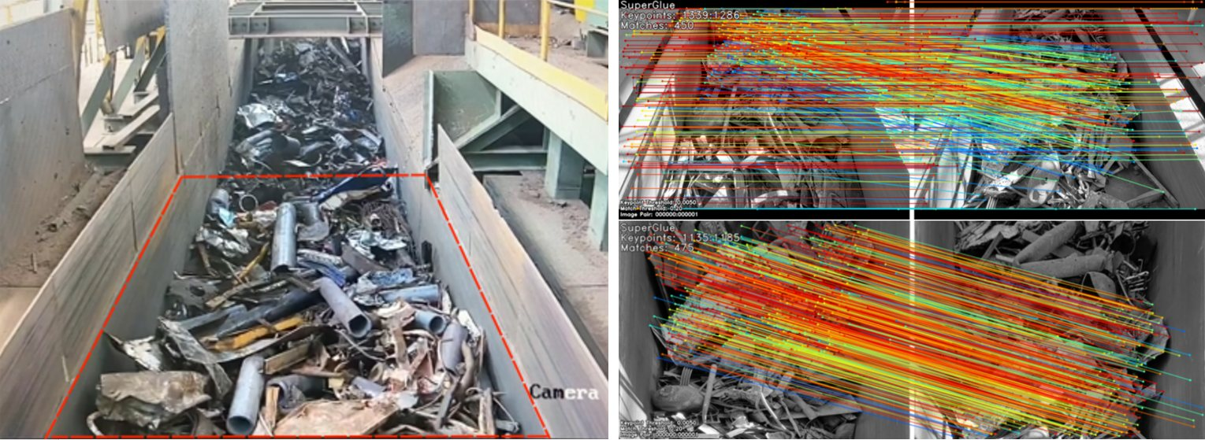
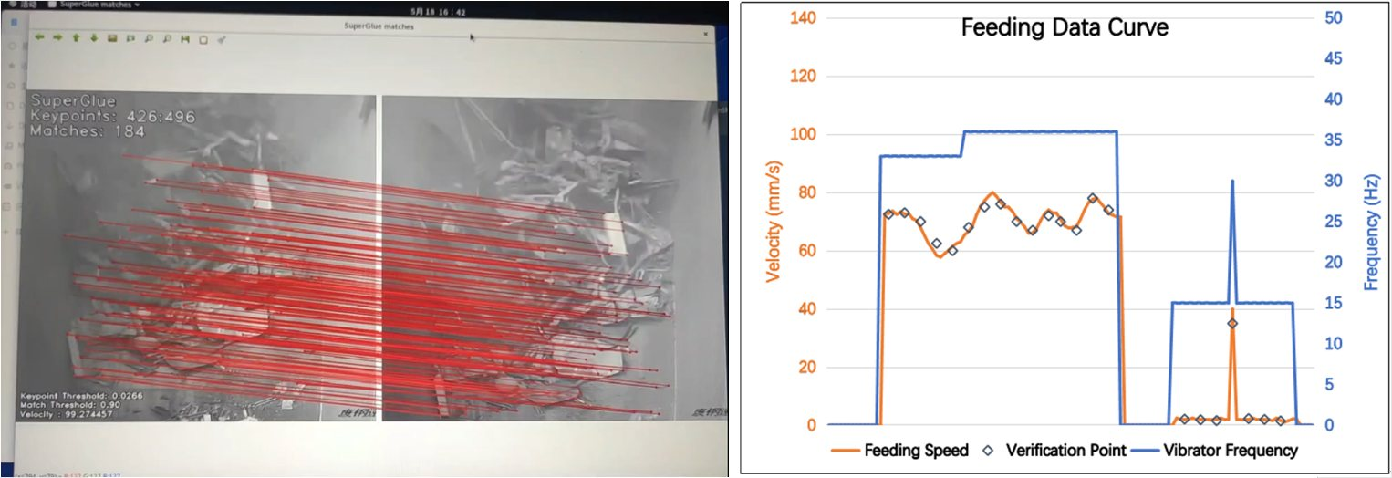
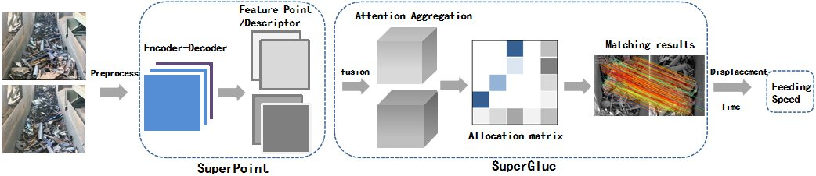
EVIDENCE 5 — VIBRATORY FEEDING
Measuring Real Scrap Feeding: It Is Possible Today
What the figures show
• Feature-point tracking (SuperPoint) measures feeding speed on real scrap — no object detection needed (Xiao et al. 2024)
• Works despite heterogeneous types, sizes, stacking & occlusion on the vibratory conveyor
• On-site validation: measured speed curve matches the horizontal-vibrator frequency curve
• → a real industrial measurement target exists for validating our DEM feeding models
Real scrap on the vibratory feeder with tracked feature trajectories (Xiao et al., 2024)
Feeding speed vs vibrator frequency — on-site data (Xiao et al., 2024)
Method pipeline (Xiao et al., 2024)
Particle-Based Modelling of Scrap Handling • evidence from the literature • TU Delft × Tata Steel
10
Notes:
This is the strongest 'industrial awareness' slide: someone at CISDI is already measuring scrap feeder speed with vision in a running plant. Our plan reuses exactly this class of measurement (plus high-speed video & load cells from Rossow/Schefler) to validate the digital twin at Tata Steel NL.

Slide 11
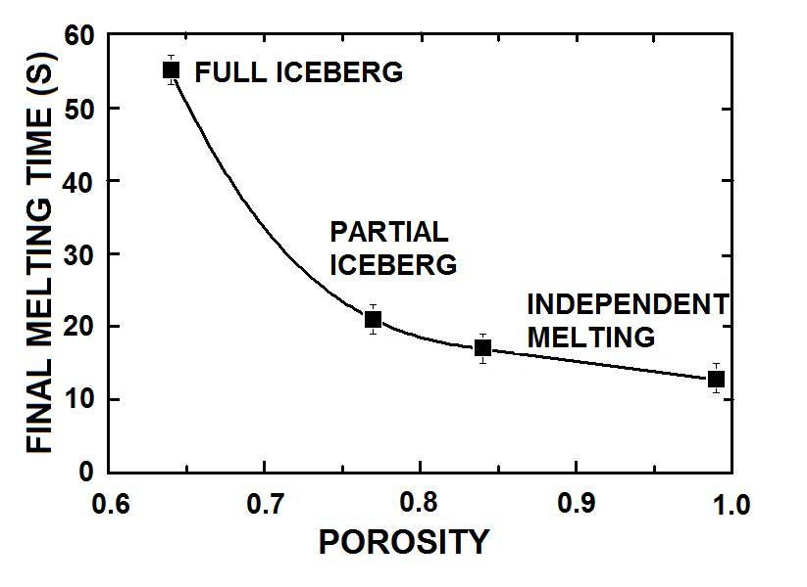
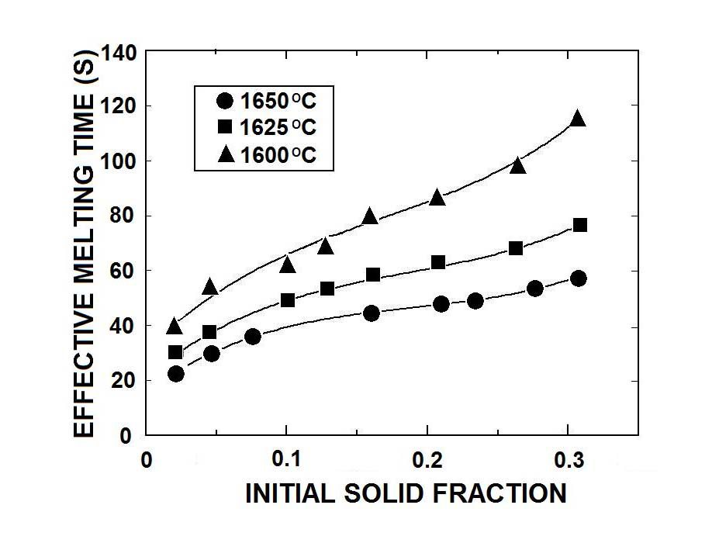
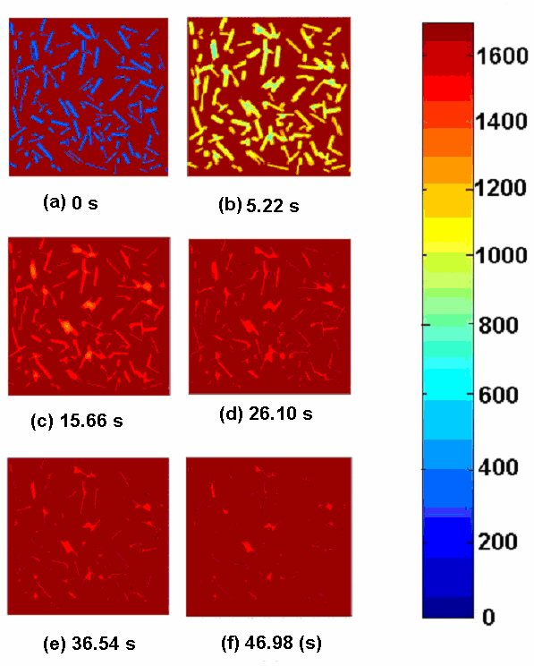
EVIDENCE 6 — INTO THE FURNACE
After the Charge: Late Melting and “Steel Icebergs”
What the figures show
• Scrap in the bath grows a solidified shell that agglomerates into “steel icebergs” — they dominate the final melting time (Li et al. 2008)
• Porosity decides the regime: full iceberg → partial iceberg → independent melting (final melting time varies 3–4×)
• The bath is virtually stagnant (thermal stratification); preheating & stirring cut melting time sharply
• → an uneven, heterogeneous charge arrives wrong → late melting, tapping delays, energy spikes
Final melting time vs porosity — iceberg regimes (Li et al., 2008, Fig. 2)
Effective melting time vs solid fraction & bath temperature (Li et al., 2008)
Link to handling
Iceberg formation is driven by how the charge packs and settles — i.e. by the mechanical infeed we propose to model. Better, more uniform feeding → smaller, more uniform melting units → shorter, steadier heats.
Phase-field melting evolution, 0 → 3393 s (Li et al., 2008, Fig. 1)
Particle-Based Modelling of Scrap Handling • evidence from the literature • TU Delft × Tata Steel
11
Notes:
The causal chain that justifies the whole project: infeed heterogeneity → charge packing/porosity → iceberg formation → late melting → energy & productivity losses (Li, Provatas & Irons 2008). This is the 'so what' behind gap 2 in the main deck.

Slide 12
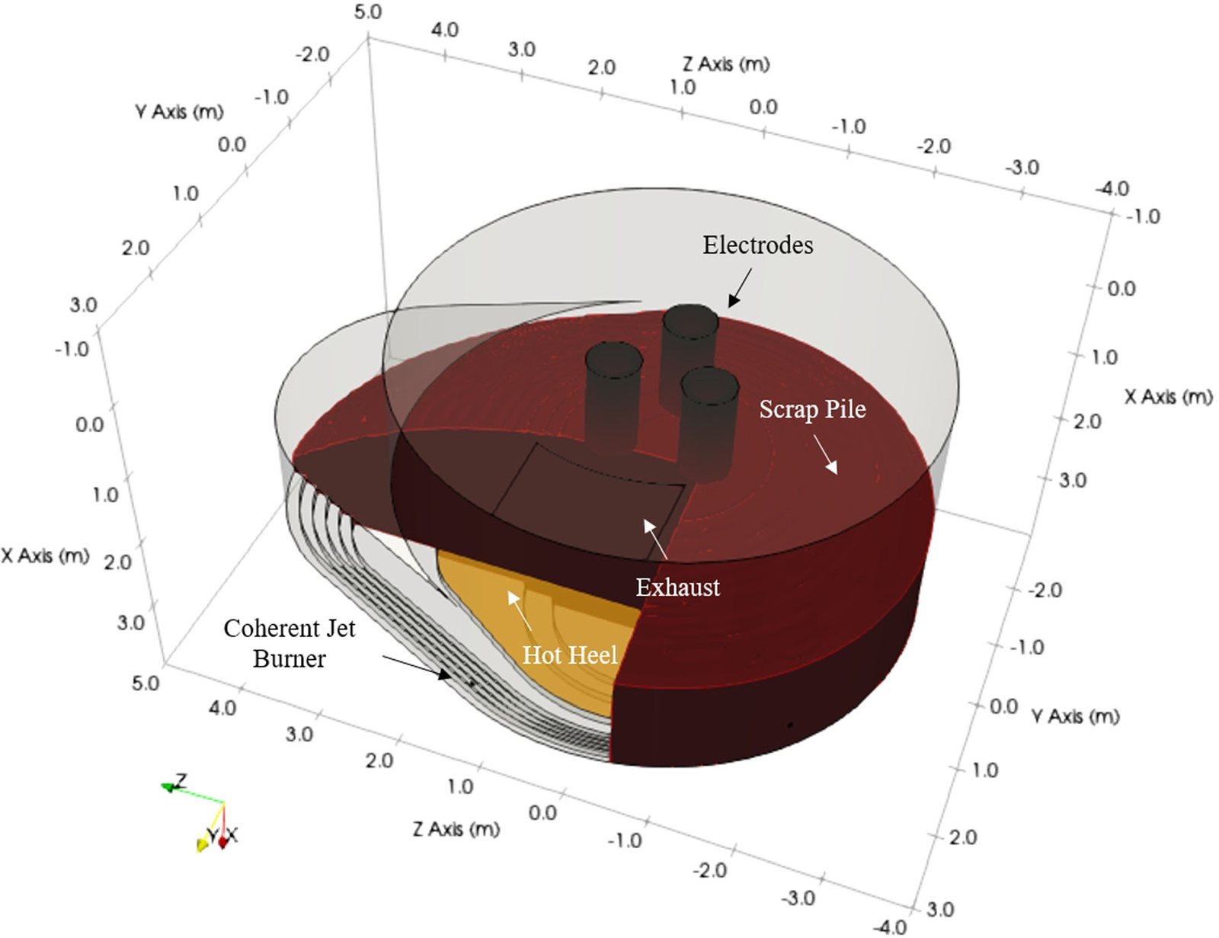
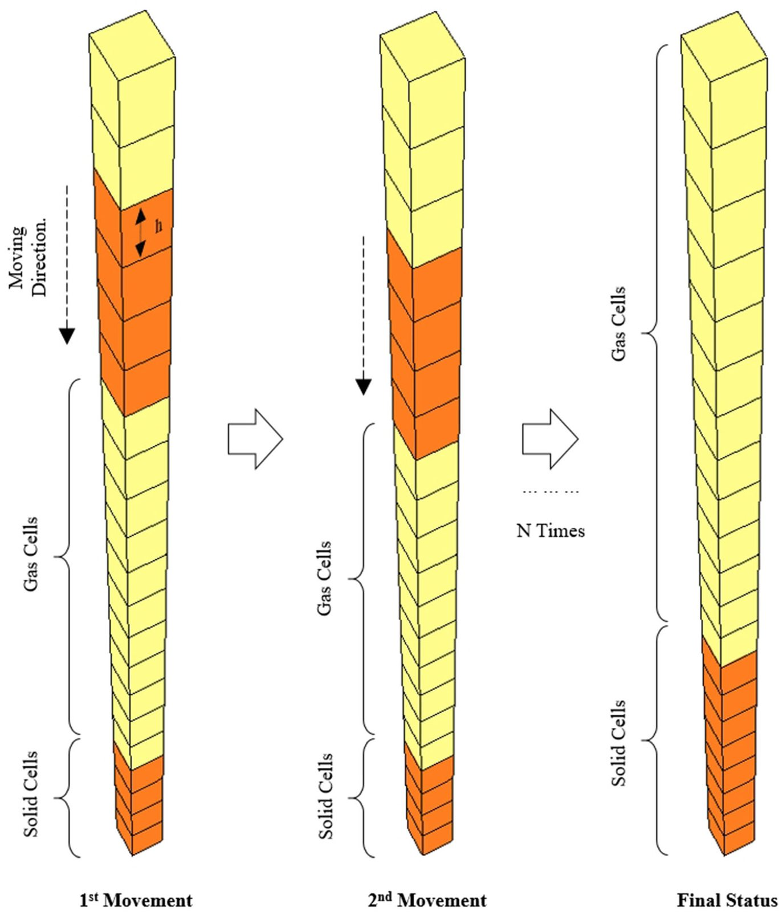
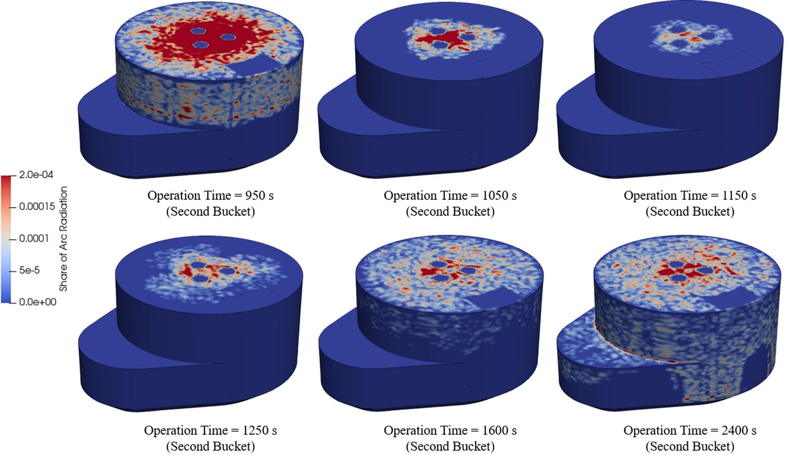
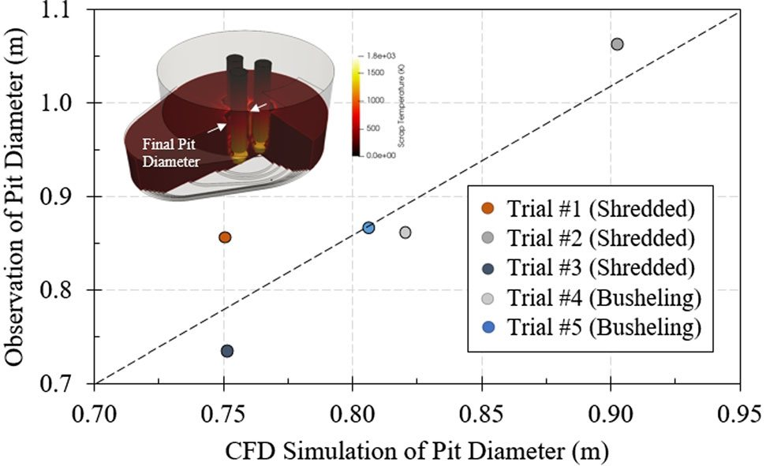
EVIDENCE 6 — INTO THE FURNACE
EAF Melting: Mature & Validated — the Infeed Is Not
What the figures show
• Fully 3-D integrated CFD: melting + collapse + arc + burners, in an industrial 150-t EAF (Chen et al. 2022)
• Scrap enters as a lumped stack input (dual-cell / stack approach) — its mechanical history is not resolved
• Validated against plant data (electrode behaviour, pit diameter: shredded & busheling)
• → melting is the strong half; the mechanical infeed upstream is the missing half
3-D EAF model: electrodes, scrap pile, coherent jet burner, hot heel (Chen et al., 2022)
Dual-cell (stack) approach for melting & collapse (Chen et al., 2022)
Melting & collapse of the second bucket (Chen et al., 2022)
Validation: measured vs simulated pit diameter (Chen et al., 2022)
Particle-Based Modelling of Scrap Handling • evidence from the literature • TU Delft × Tata Steel
12
Notes:
Balance slide: we do NOT question EAF melting modelling — it is excellent and industrially validated. Our contribution is everything upstream: how the charge actually arrives (structure, sequence, segregation). The digital twin hands off to models like this one.

Slide 13
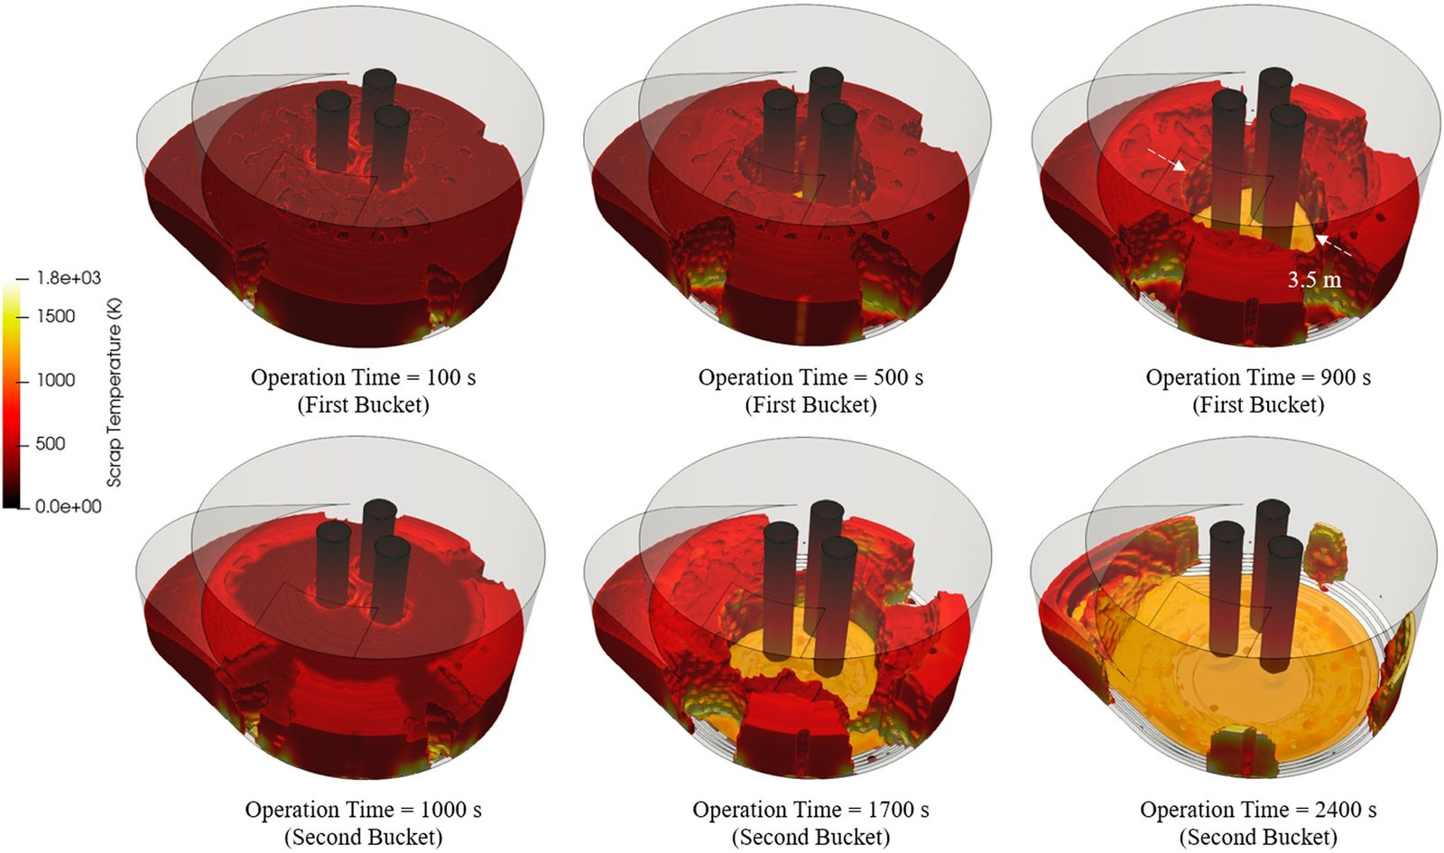
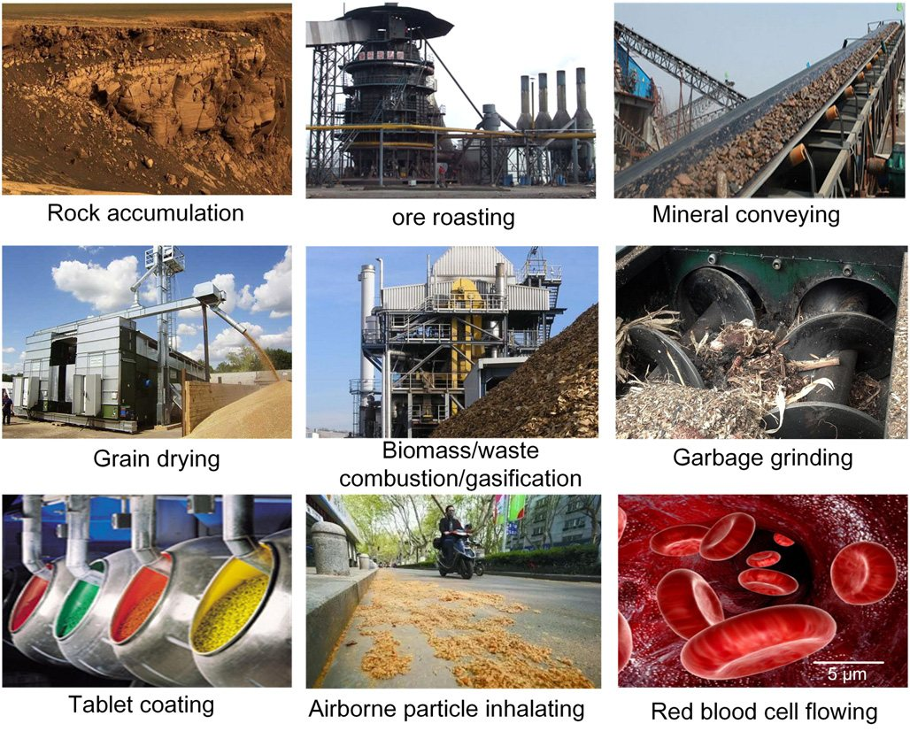
CONCLUSION — THE GAP & THE PHD PROJECT
Both Ends Are Mature — the Infeed Interface Is Missing
DEM applications across industry — bulk handling is everywhere (Zhong et al., 2016, Fig. 1)
Charge buckets enter the furnace as discrete, structured inputs (Chen et al., 2022)
Conveyor / chute DEM — mature, calibrated, validated (Rossow 2021; Schefler 2023; You 2018)
EAF melting CFD — mature, industrially validated (Chen 2022; Li 2008)
Heterogeneous scrap infeed — the missing link — size, shape, density, chemistry, real-time segregation
Particle-Based Modelling of Scrap Handling • evidence from the literature • TU Delft × Tata Steel
13
Notes:
The closing argument, backed by figures: mature DEM + mature CFD + missing interface = the PhD. The project builds the interface: a multi-scale, multi-property digital twin of EAF scrap infeed, calibrated on Tata Steel NL data over 4 years.

Slide 14
SUPPORTING LITERATURE
Figure Sources (papers in the repository)
[1] Lu G., Third J.R., Müller C.R. (2015). Discrete element models for non-spherical particle systems: from theoretical developments to applications. Chemical Engineering Science 127: 425–465. — Figs 1, 3, 6, 14, 32, 4b, Eq. 16
[2] Rossow J., Coetzee C.J. (2021). Discrete element modelling of a chevron patterned conveyor belt and a transfer chute. Powder Technology 391: 77–96. — Figs 1, 3, 8, 10, 13, 21, Table 9
[3] Schefler O.C., Coetzee C.J. (2023). Discrete element modelling of a bulk cohesive material discharging from a conveyor belt onto an impact plate. Minerals 13(12): 1501. — discharge, build-up & DEM profile figures
[4] You Y., Liu M., Ma H., et al. (2018). Investigation of the vibration sorting of non-spherical particles based on DEM simulation. Powder Technology. doi:10.1016/j.powtec.2017.11.002 — Figs 6, super-ellipsoids, sorting patterns
[5] Xiao X., Zhong X., Ma M., Wu X. (2024). A visual based algorithm for measuring the speed of scrap metal vibration feeding. CSAE 2024 (ACM). doi:10.1145/3704814.3704817 — feeder tracking, speed curve, pipeline
[6] Li J., Provatas N., Irons G.A. (2008). Modelling of late melting of scrap in an EAF. AISTech 2008, Irons A8046. — Figs 1, 2, melting-time charts
[7] Chen Y., Ryan S., Silaen A.K., Zhou C.Q. (2022). Simulation of scrap melting process in an AC electric arc furnace: CFD model development and experimental validation. Metall. Mater. Trans. B 53: 3256–3272. — 3-D model, dual-cell, sequence, pit validation
[8] Zhong W., Yu A., Liu X., Tong Z., Zhang H. (2016). DEM/CFD-DEM modelling of non-spherical particulate systems: theoretical developments and applications. Powder Technology 300: 109–127. — Figs 1, 20, 45
[9] Kryszak D., Bartoszewicz A., Szufa S., Piersa P., Obraniak A., Olejnik T.P. (2020). Modelling of transport of loose products with the use of the non-grid method of discrete elements (DEM). Processes 8(11): 1489. — force spectra on conveyed product
[10] Garg R., Galvin J., Li T., Pannala S. (2012). Documentation of open-source MFIX-DEM software for gas-solids flows. NETL/ORNL.
[11] Kozicki J., Tejchman J. (2005). Application of a cellular automaton to simulations of granular flow in silos. Granular Matter 7: 45–54.
[12] Ahmed H., Pang Y., Adema A., et al. (2026). Industrial-scale DEM modelling of segregation in the blast furnace charging system (Tata Steel IJmuiden). Powder Technology.
Particle-Based Modelling of Scrap Handling • evidence from the literature • TU Delft × Tata Steel
14
Notes:
All figures were extracted from the PDFs in 'papers/particles-based models' (see file names in the slide captions). Permission note: figures are reproduced for the PhD interview presentation of the repository owner, who holds these papers; keep this use non-public.

